Slide 1
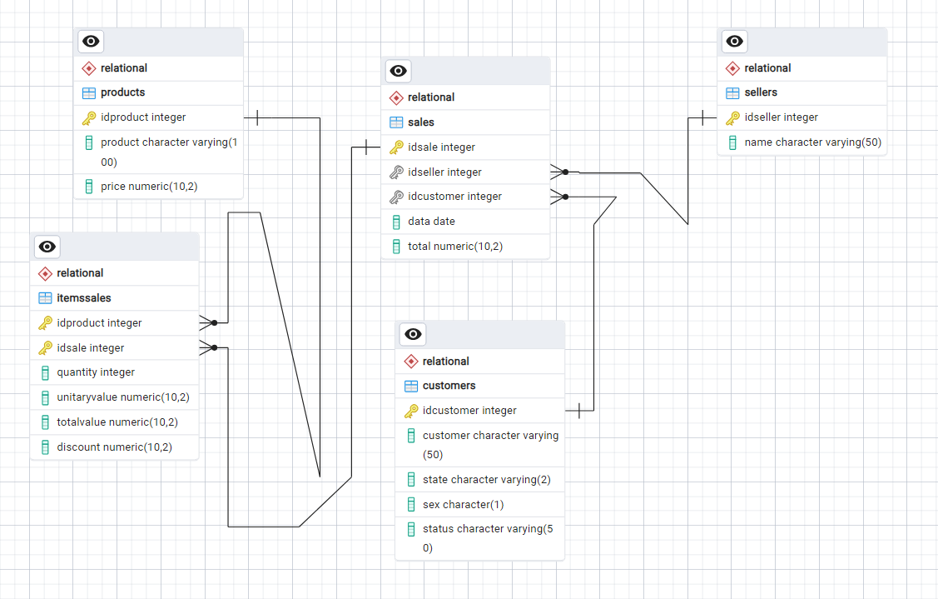
Data Diagram Relational Database – JJ Bike
On the left side we can see the relational data diagram, this model is focused on the referential integrity of the database following ACID rules (Atomicity, Consistency, isolation, durability), one part is taken care of by the database system, but others, it needs to be implemented by the analyst.
In this case some rules are followed, for example not allowing orphaned records, orphaned records means that the data lost its link with the transactional table because the main record was deleted and the deletion was not propagated to all dependencies , which is why the primary key and foreign keys are created in the tables together with restrictions that allow blocking actions that cause inconsistency in the database, as an example we have blocking the deletion of records that could generate orphan records and allows deletion as long as it is propagated in all related tables.
And the transaction table does not allow duplicate records.
If you have registration data in the transactional table, in this case we need to create a table separately and create a connection link with the transactional table.
On GitHub I placed the file called Relation Model - JJ Bike.pgerd this is the postgre relational model and can be opened using the program called pgAdmin 4 that comes with the postgree database.

Slide 2
Main characteristics of the Relational Database
In this case, our database aims to simulate the transactional and operating environment in one company.
Toda empresa que possui uma organização mínima possui um sistema transacional para registrar todas as transações da empresa como vendas e controle de estoque, essas informações são registradas em um banco de dados chamado banco de dados de transações.
As the transactional database is built only to record transactions and generally does not allow reading this type of database to extract reports, as this type of action increases the number of requests to the database and creates problems for the recording sales transactions from the sales or inventory control system.
Because of these facts, the transaction database is dedicated only to the use of transactional systems in the company such as sales, inventory control and employee and salesperson registration and things like that.
And the database for extracting information for generating reports, dashboards and analyzes is another separate Database, built specifically for this purpose. In our case, the Data Warehouse model was used, this is a dimensional Database, built exclusively for be used as a data query source.

Slide 3
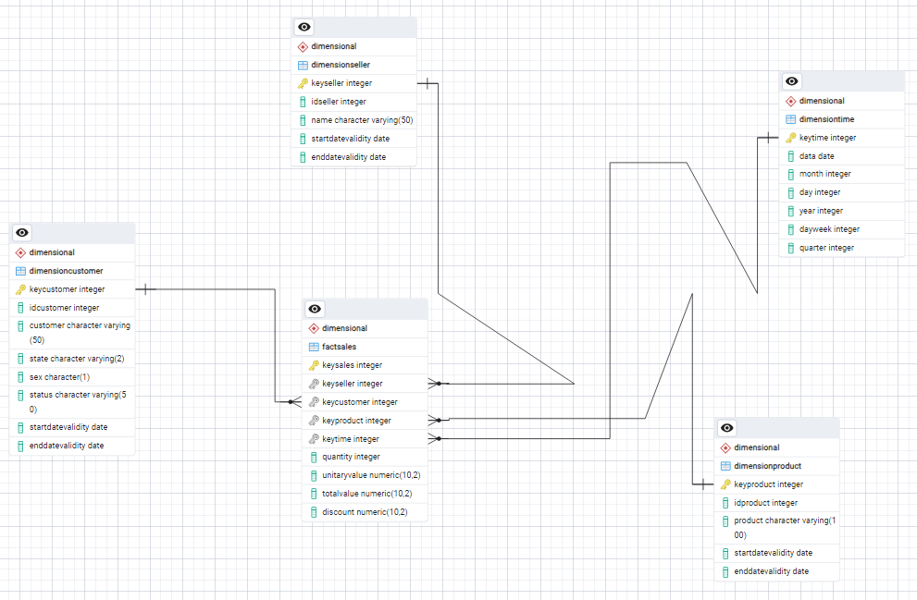
Data Diagram Dimentional Database – Data Warehouse
On the left side we can see the data diagram of the dimensional model of the data warehouse database.
This model was used, it was the Star schema model, in this model we have in the center the FactSales (Fact Table) and other tables directly connected to the Fact Table called dimensional tables in this model the dimensional tables do not have any subtables directly connected to them, this connection type using subtables exists only in Model Snow Flakes but this is a more complex and slower model, the star schema of the model that was used in our data warehouse is simpler but the query results are faster.
On GitHub I placed the file called Dimensional Model - JJ Bike.pgerd this is the postgre relational model and can be opened using the program called pgAdmin 4 that comes with the postgree database.

Slide 4
Main characteristics of the Dimensional Database - Data Warehouse
Different from the Relational Database, the Data Warehouse is based on a Dimensional Model, has a different proposal from the Relational Database, in this case this Database is Built exclusively for queries and generations, reports, dashboards and analyzes and has specific characteristics and distinct from the Relational Database.
The first thing to say is that the Data Warehouse does not make requests to the transactional database during business hours, in this case the loading of data whose origin is the transactional database is done at times of low commercial demand, such as late afternoon . night or early in the morning and because this does not cause problems in commercial transactions.
Another characteristic is that this type of data is summarized, that is, it does not need all the details about these transactions, but a level is chosen, this level is called a granule, it is the smallest data point in the Data Warehouse and in this case they are sales transactions, this granule makes a sum per level, for example, all sales in a store per day, per salesperson and per customer, this type of construction allows the Data Warehouse to have information of great value and does not take up much space in the database.
Another characteristic is in the relationships between the tables the dimensional model in the dimensional model we have in the center the main table with sales information and around it we have the dimensional tables with direct relationships with the main table, these dimensional containing registration information for example we have table of products, sellers table etc...
And it allows records of registration changes to be kept in tables that occurred in the transactional database. This type of historical changes is not allowed to be kept in the transaction database because they cause inconsistency in the database, but we do not have this problem in the Data Warehouse because it was building support for this and maintaining historical changes and allows analyzes to be carried out based on these historical changes
As the Data Warehouse is used only for queries, it has no competition with other applications, and the volume of data is smaller than the transaction environment, and few numbers of registration tables are used in dimensional tables in relation to the transaction environment, in this case we use only the registration information that is relevant for the analysis, the complexity of the queries are simpler than the transactional environment which makes it return data faster and even so the data quality is excellent because of this the Data WareHouse becomes a wonderful source of data for quick extraction of reports, construction of dashboards and analyzes with excellent performance and generating great value for the business.

